Slide 1


Lesson 8
What does a true friend do?
UNIT 2

Slide 2
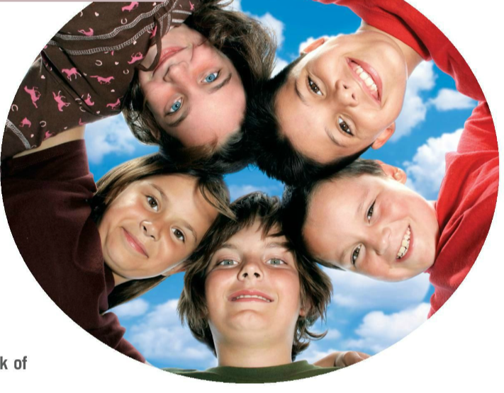
Let’s talk about friendship…
Take a piece of paper and draw your hand.
Write the names of your kindergarten and preschool best friends on your little finger and ring finger.
Who was your best friend in lower primary school?
Write his/her name on the middle finger on your drawing.
Lastly, think of your present best friends and write their names on your forefinger and thumb.
Now look at the drawing of your hand and your friends. Has anything changed? What is a true friend like?

Slide 3
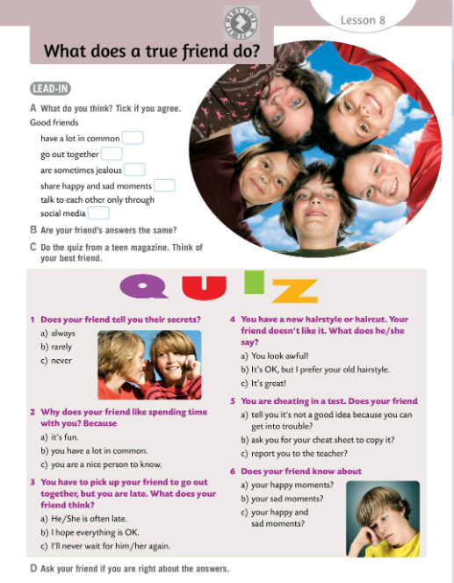
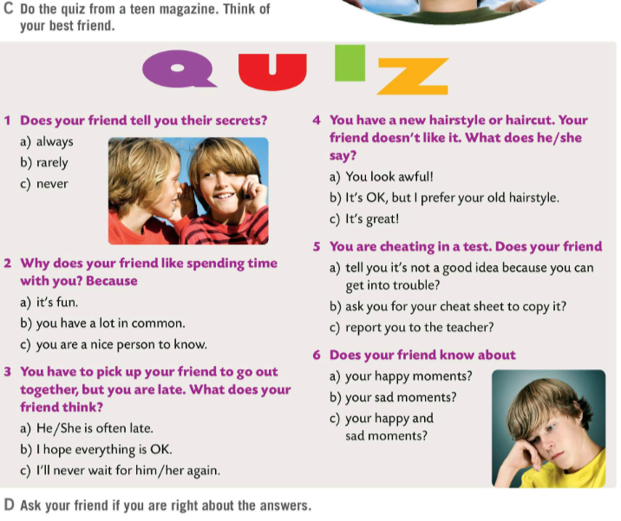
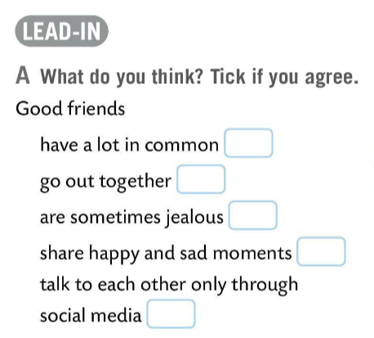
Read the sentences in Task A and tick the ones you agree with.
Are your and your friend’s answers the same? Discuss your answers in class.
Do the quiz in Task C. Think of your best friend while doing the quiz.
Ask your friend if you are right about the answers.

Slide 4
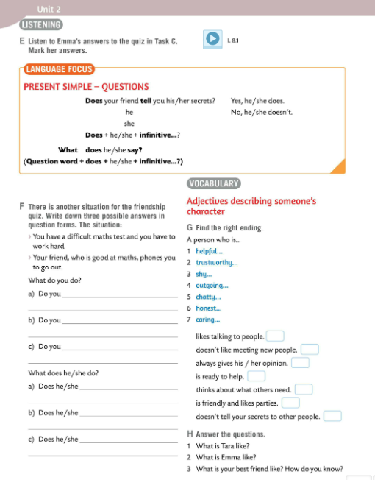

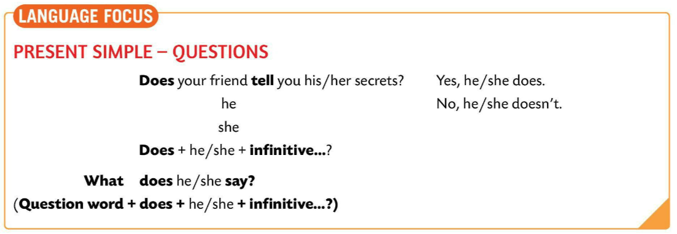
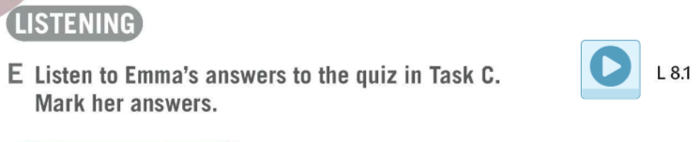

Listen to Emma’s answers to the quiz in Task C. Mark her answers.
Check.
LANGUAGE FOCUS
We form Yes/No questions with DOES before the subject of the sentence
DOES + subject + verb (infintive)…?
DOES he walk every day?
REMEMBER that we DO NOT add –s or –es to the verb!
Kratka pitanja tvorimo tako da ispred subjekta dodamo pomoćni glagol DOES. ZAPAMTI kako glagolima ne dodajemo nastavak –s ili –es u upitnim rečenicama.
e.g.

Slide 5
LANGUAGE FOCUS
We form Wh- questions with the question word at the beginning.
QUESTION WORD +DOES + subject + verb (infinitive)
What, where, why, how much…
REMEMBER that we DO NOT add –s or –es to the verb!
What does she say?
Wh- pitanja tvorimo tako da upitnu riječ stavimo na početak rečenice. Ispred subjekta dodajemo glagol DOES.
ZAPAMTI kako glagolima ne dodajemo nastavak –s ili –es u uputnim rečenicama!

Slide 6
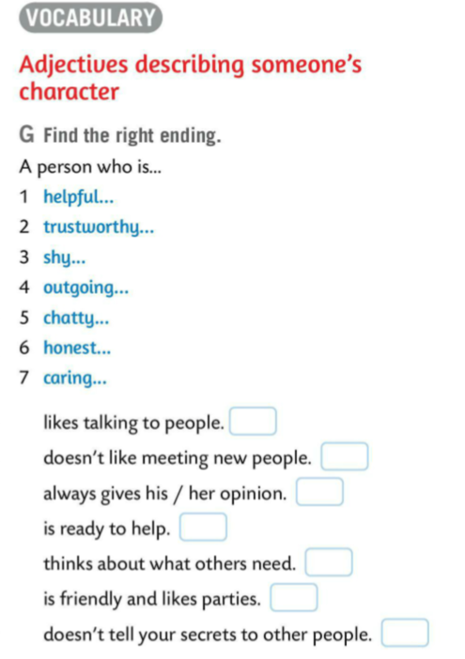
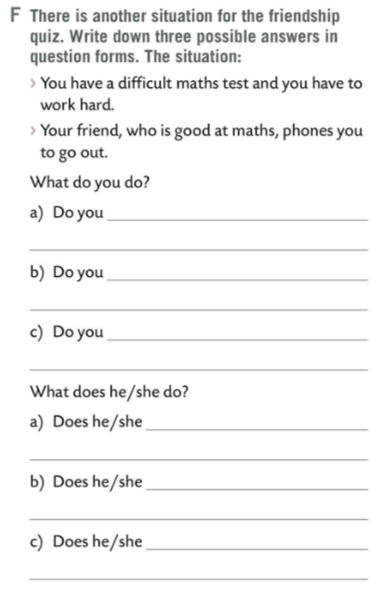
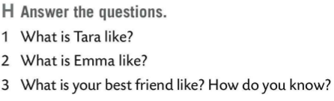
Do Task F. Write down three possible answers in question forms.
Check in pairs.
Read questions to your friend. He/She has to check if the question is correct and then read your anwers to the class.
Tara is shy, honest, caring, and helpful.
How would you describe someone’s character? Find the right ending in Task G.
Emma is outgoing and chatty.
5
3
6
1
7
Check.
4
2
Answer the questions in Task H in your notebook. Present your answers in class.

Slide 7
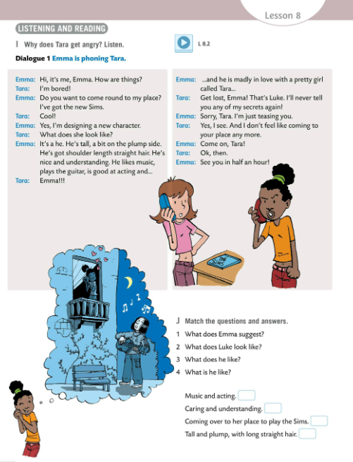
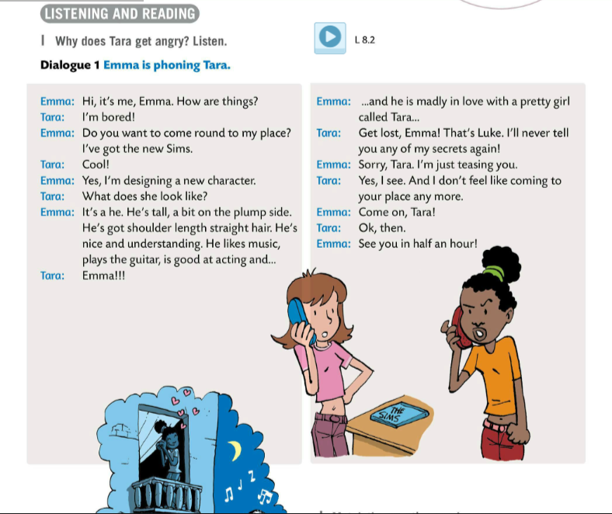
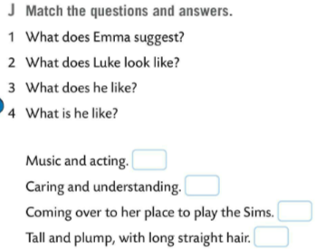
Listen to the Dialouge 1. Why does Tara get angry? Listen.
Listen to the Dialouge 1 once again and then read the text.
Match the questions and answers in Task J.
Check.
3
4
1
2

Slide 8
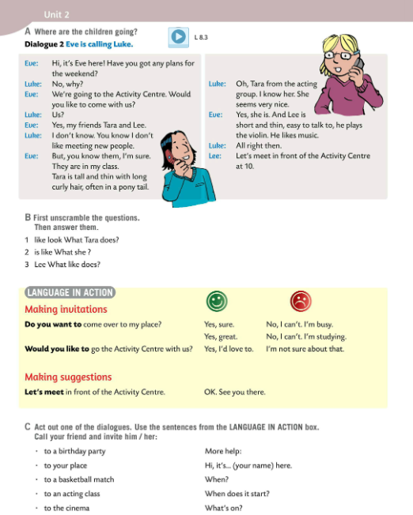
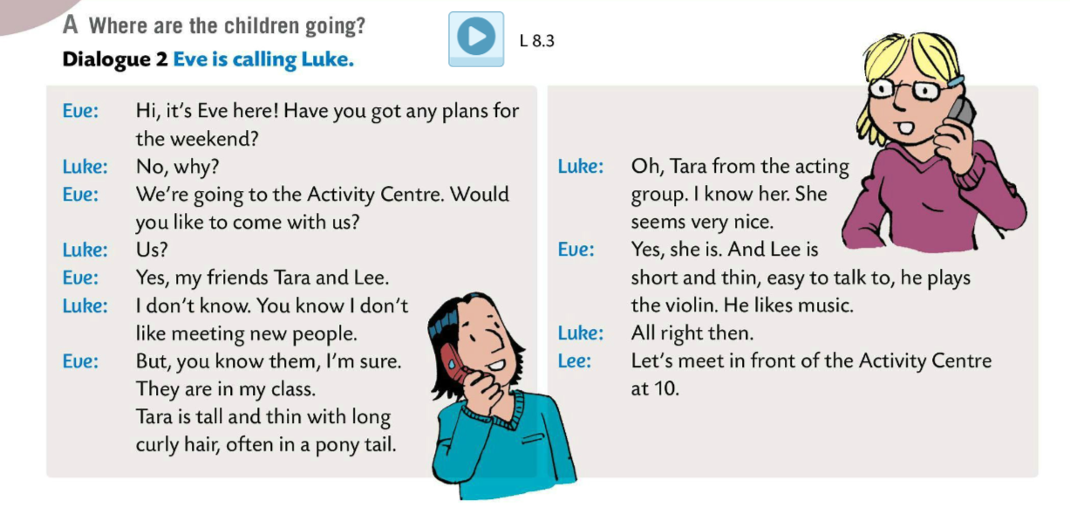
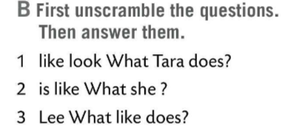
Listen to the Dialouge 2. Where are the children going?
Listen to the Dialouge 2 one more time and then read the text.
Unscramble the questions in Task B and then answer them.
Check.
1 What does Tara look like? She is tall and thin with long curly hair, often tied into a ponytail.
2 What is she like? She is nice.
3 What does Lee like? He likes the music.

Slide 9
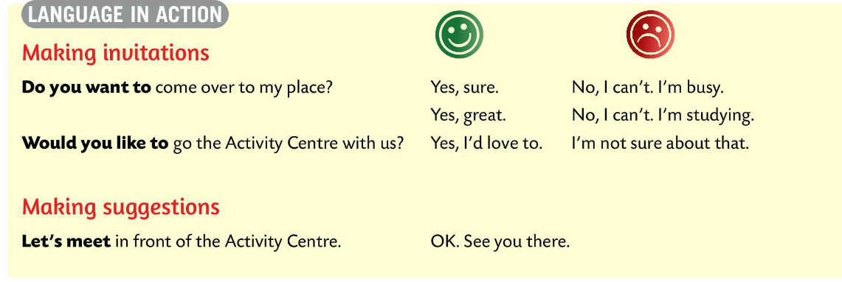
LANGUAGE IN ACTION
When we want to invite someone somewhere, we ask:
Kada želimo nekoga pozvati negdje pitamo sljedeće:
1 Do you want to come over to my place?
Possible answers:
Yes, sure/great. OR No, I can’t. I’m busy/I’m studying.
2 Would you like to go to the theatre with us?
Possible answers:
Yes I’d love to. OR I’m not sure about that.

Slide 10
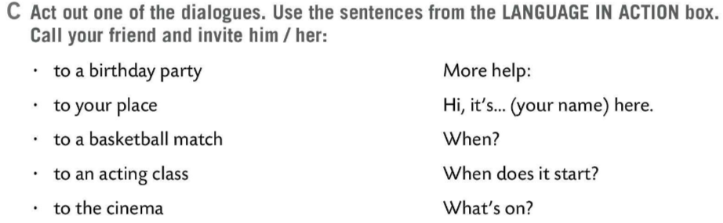
LANGUAGE IN ACTION
When we try to make suggestions we use the following structure:
Kada želimo predložiti nešto, koristimo sljedeći izraz:
Let’s + verb
Let’s meet in front of the Mall.
OK. See you there.
Act out one of the dialogues in Task C. Use the sentences from the LANGUAGE IN ACTION box.
Call your friend and invite him/her somewhere.

Slide 11
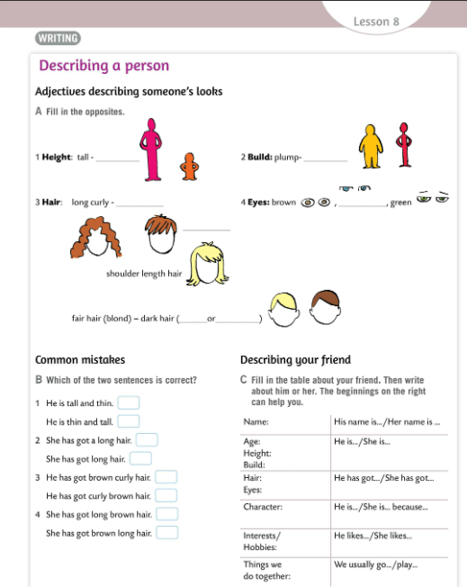
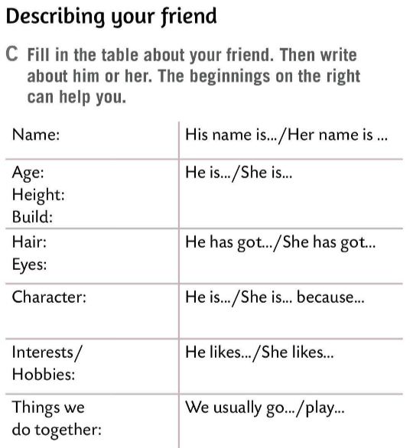
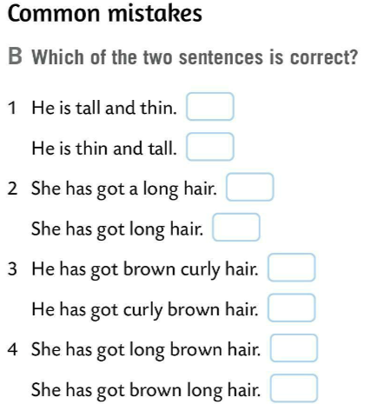

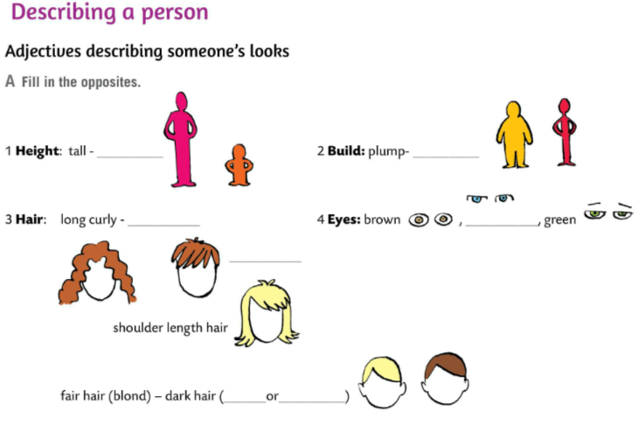
What are the adjectives that we use to describe someone’s looks?
Fill in the opposites in Task A.
Check.
short
thin
Read the sentences in Task B. Decide which of the two sentences is correct.
short straight
blue
Check.
Do Task C.
Fill in the table about your friend. Then write about him/her.
brown
black

Slide 12
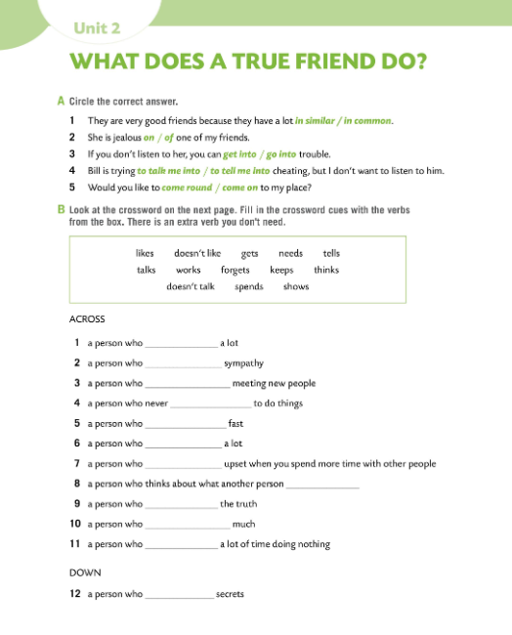
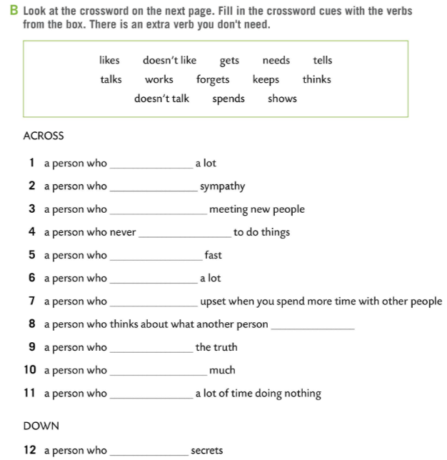

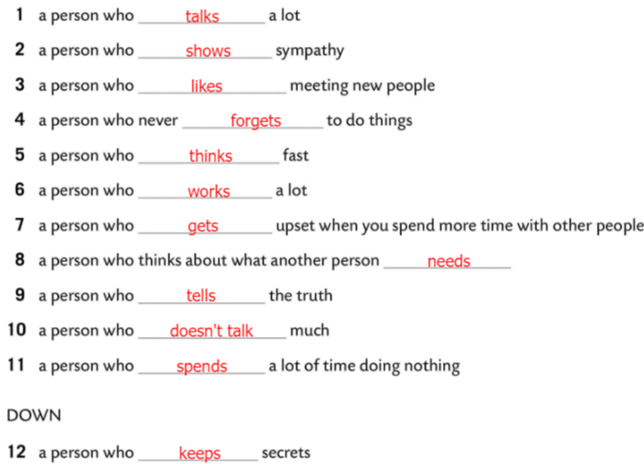
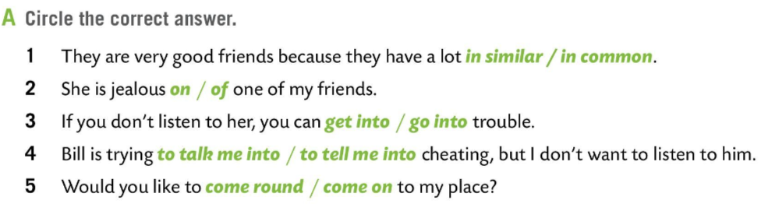
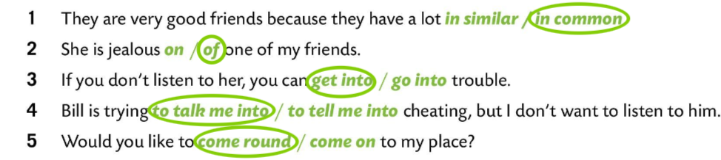
Workbook, page 42.
Circle the correct answer in Task A.
Check.
Fill in the crossword cues with the verbs from the box. There is an extra verb you don’t need.
Check.
Check your knowledge.
https://wordwall.net/play/6452/780/650

Slide 13
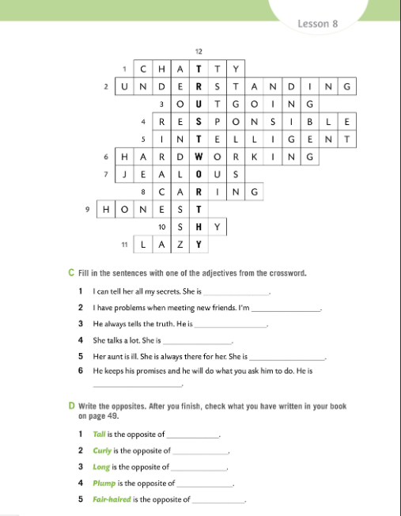
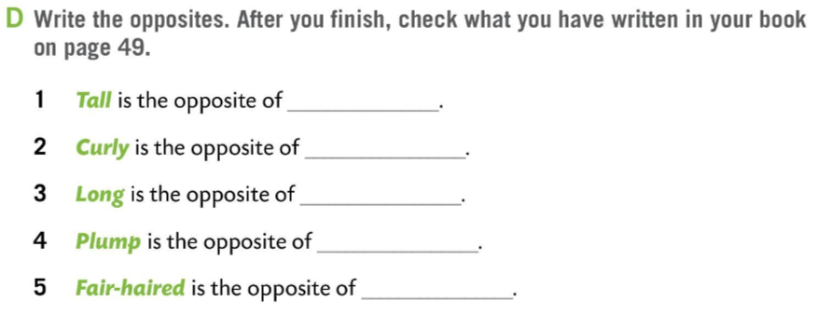
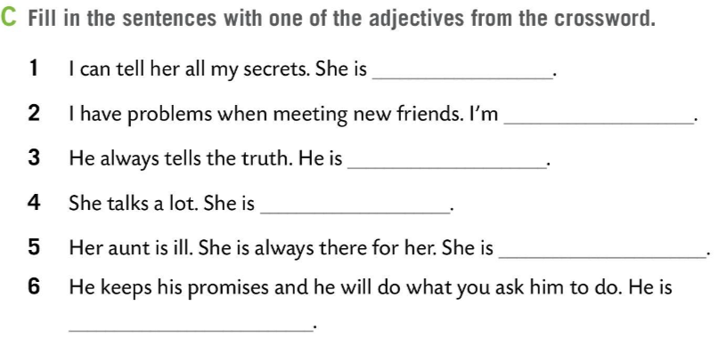
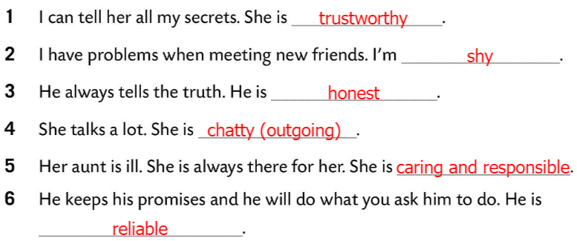
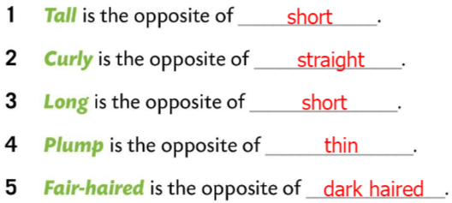
Workbook, page 43.
Fill in the sentences in Task C with one of the adjectives from the crossword.
Check.
Write the opposites. After you finish, check what you have written on your book on page 49.
Check.

Slide 14
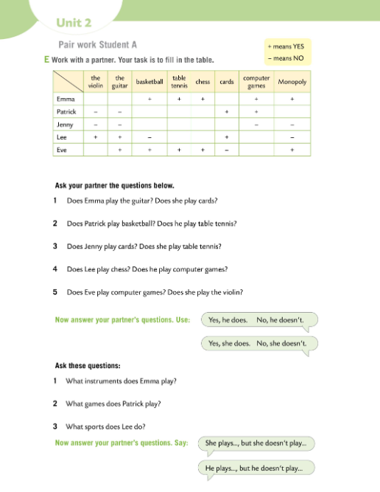
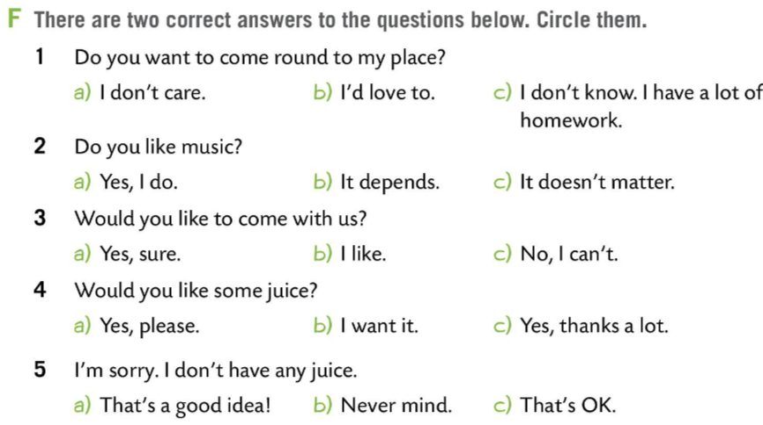
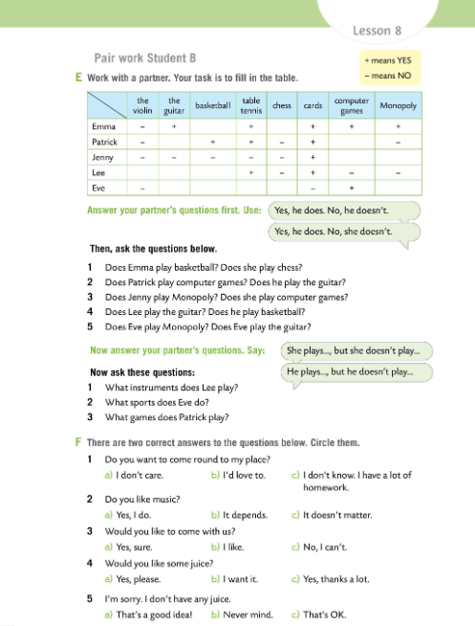
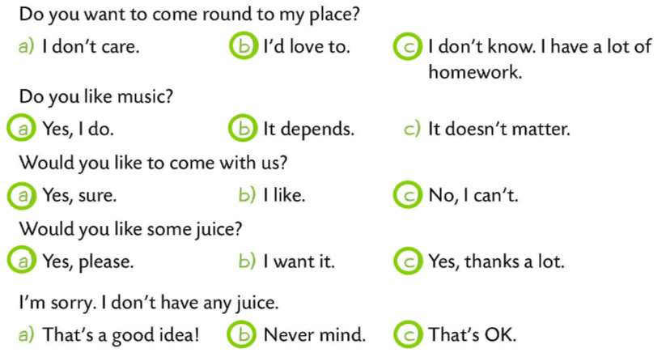
Workbook, page 44 & 45.
Do Task E in pairs. Follow the directions and check with the teacher.
There are two correct answers in Task F. Circle them.
Check.
Check your knowledge.
https://wordwall.net/play/6875/620/465

